Slide 1
A MATHEMATICAL MODEL OF NEUROIMMUNE INTERACTIONS IN EPILEPTOGENESIS FOR DISCOVERING TREATMENT STRATEGIES
University of Trento
Anastasia Santo , Rayan Slatni
Prof. Andrea Pugliese
Quantitative and Computational Biology (CIBIO)

Slide 2
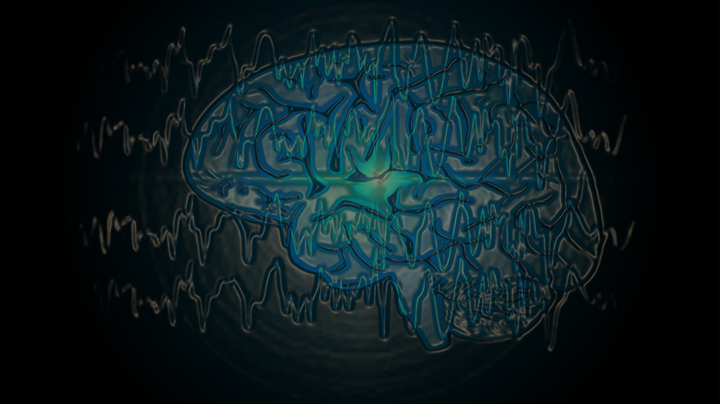
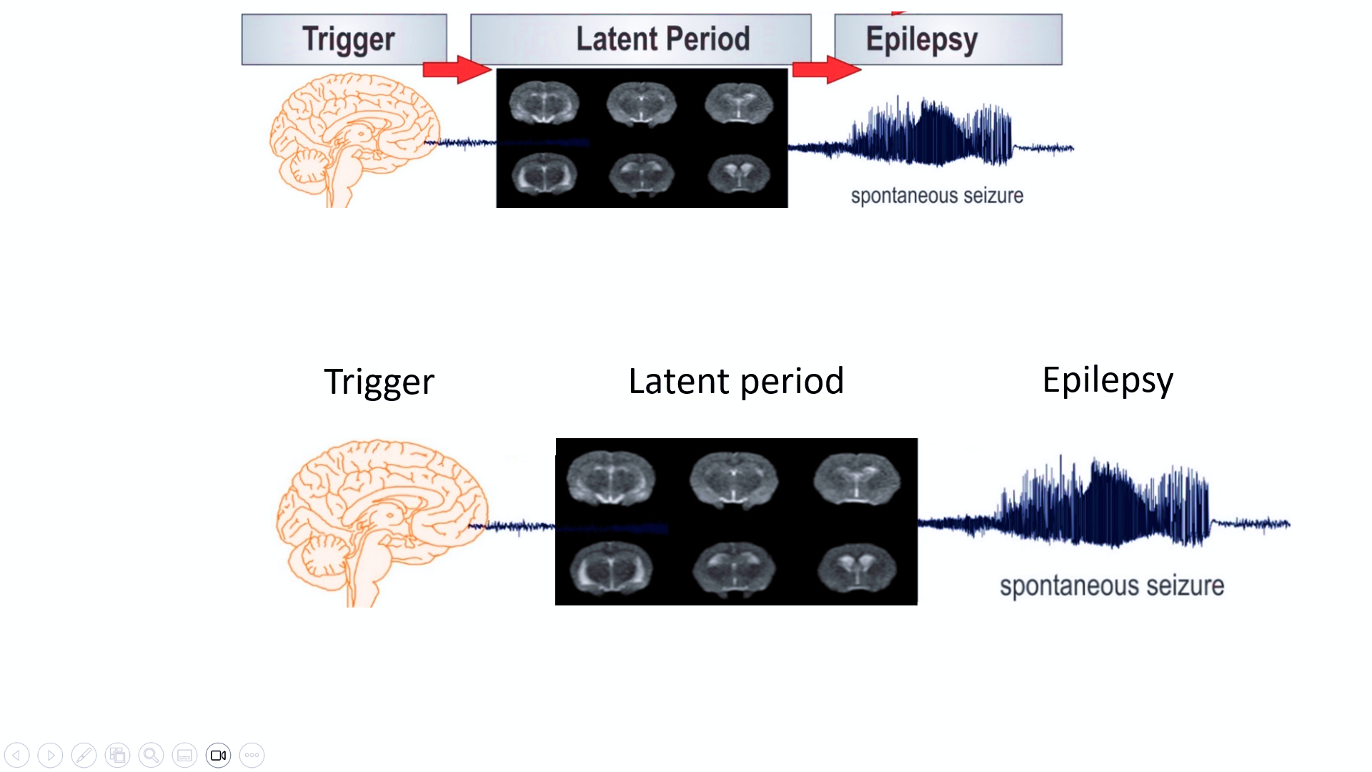
What is Epilepsy?
-Epilepsy is a brain disorder that causes recurring, unprovoked seizures.
-Seizures are sudden surges of abnormal and excessive electrical activity in your brain; where and how the seizure presents itself can have profound effects.
What is Epileptogenesis?
Is the gradual process by which a typical brain develops epilepsy.
It’s a chronic process that can be triggered by genetic or acquired factors.
After a brain injury there is frequently a "latent period" in which seizures do not occur.

Slide 3
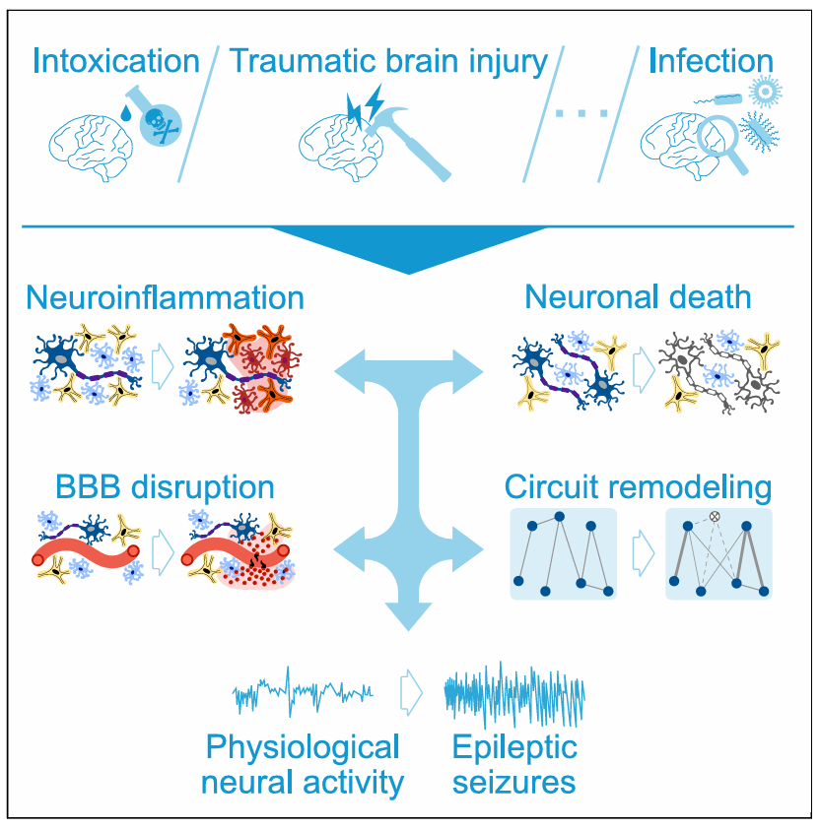
TRAUMATIC BRAIN INJURY
(I) Activation of innate and adaptive immune responses
(B) Disruption of the blood-brain barrier (BBB) integrity
(D) Neuronal loss
(R) Remodeling of neural circuits
Changes is physiological neural activity
(S) Epiletic seizures
Fig.1 Schematics representation of epileptogenesis

Slide 4
PURPOSES OF THE MODEL :
Description and simulation of the course of acquired epilepsy development caused by the most common types of neural injuries using a single parameter set.
It accounts for the complex epileptogenic role of neuroimmune interactions.
It suggests an explanation for why the development of epilepsy may take months or years after the triggering injury in certain cases.
It provides insights into the general principles of EPG and allows us to generate testable predictions for different therapeutic strategies.
-TMEV mouse model.
-Pilocarpine SE rodent model
-BBB disruption rodent model.

Slide 5
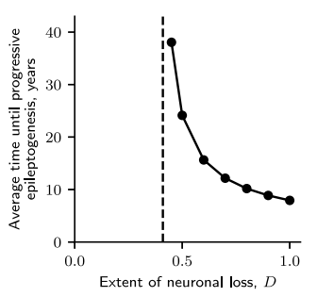
PURPOSES OF THE MODEL :
Description and simulation of the course of acquired epilepsy development caused by the most common types of neural injuries using a single parameter set.
It accounts for the complex epileptogenic role of neuroimmune interactions.
It suggests an explanation for why the development of epilepsy may take months or years after the triggering injury in certain cases.
It provides insights into the general principles of EPG and allows us to generate testable predictions for different therapeutic strategies.
Fig.01 Average time until inevitable progressive EPG for different extents of neuronal loss obtained with rate model. Black dashed line corresponds to the critical extent of neuronal loss Dcritical=0.41.

Slide 6
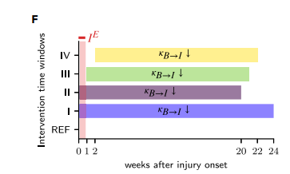
PURPOSES OF THE MODEL :
Description and simulation of the course of acquired epilepsy development caused by the most common types of neural injuries using a single parameter set.
It accounts for the complex epileptogenic role of neuroimmune interactions.
It suggests an explanation for why the development of epilepsy may take months or years after the triggering injury in certain cases.
It provides insights into the general principles of EPG and allows us to generate testable predictions for different therapeutic strategies.
Fig.02 Time windows of four interventions with suppression of the activation of glia by factors infiltrating the parenchyma. Light red area corresponds to the period of injury induction.

Slide 7
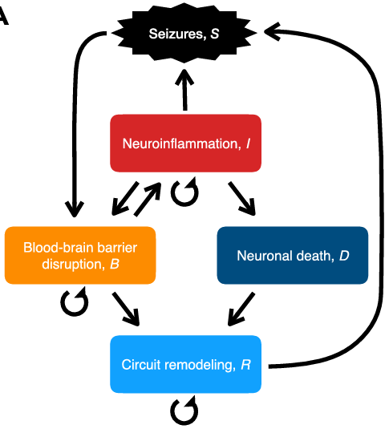
Model design:
I -> S Neuroinflammatory response modulate neuronal excitability → lower seizure threshold.
R -> S Pathological remodeling → increase of excitability in neuronal circuits and rising in the chance of critical synchronization that results in the occurrence of spontaneous seizures .
SEIZURE PROMOTING FACTORS
Fig.2 Schematics representation of the variable interaction in epileptogenesis

Slide 8
Model design:
S -> B Seizures induce metabolic stress and leakiness of the BBB
B -> I Neuroinflammation can be caused by exposure of the parenchyma to cells or soluble factors infiltrating through the leaky BBB
I -> B Neuroinflammation can cause leakiness of the BBB
I -> D Excessive neuroinflammation may lead to neurotoxicity
D -> R Neural loss leads to the remodeling of neural circuits
B -> R Extravasation on BBB dysfunction ledas to pathological remodelling
Fig.2 Schematics representation of the variable interaction in epileptogenesis

Slide 9
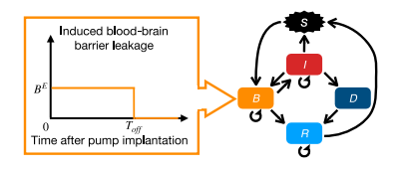
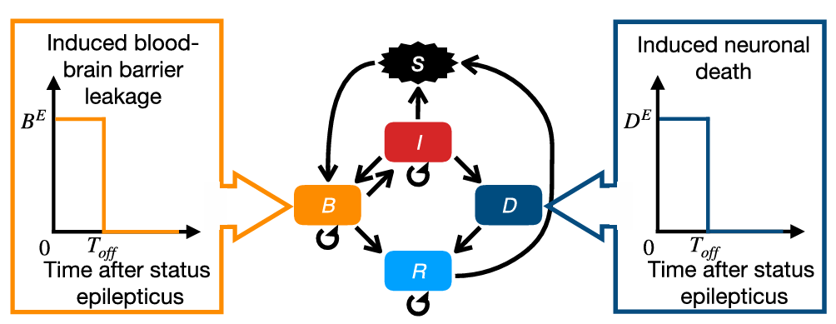
SIMULATION PERFORMED ON THREE INJURY TYPES AND ASSOCIATED ANIMAL MODELS:
Theiler’s murine encephalomyelitis virus (TMEV) mouse model [infection]
Chemically induced (pilocarpine) SE rodent model [chemical intoxication]
BBB disruption rodent model [BBB leakage]
Params:
['IBDR_E_duration’]
['IBDR_E_amplitude’]
['Complex_input ]
['amount_simulations’]
['number_simulation']
Fig. 3 Simulation schematics for BBB disruption rodent model and SE model

Slide 10

MATHEMATICAL DESCRIPTION OF THE MODEL

Slide 11
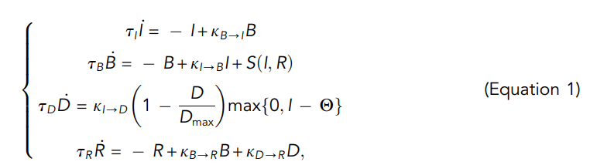
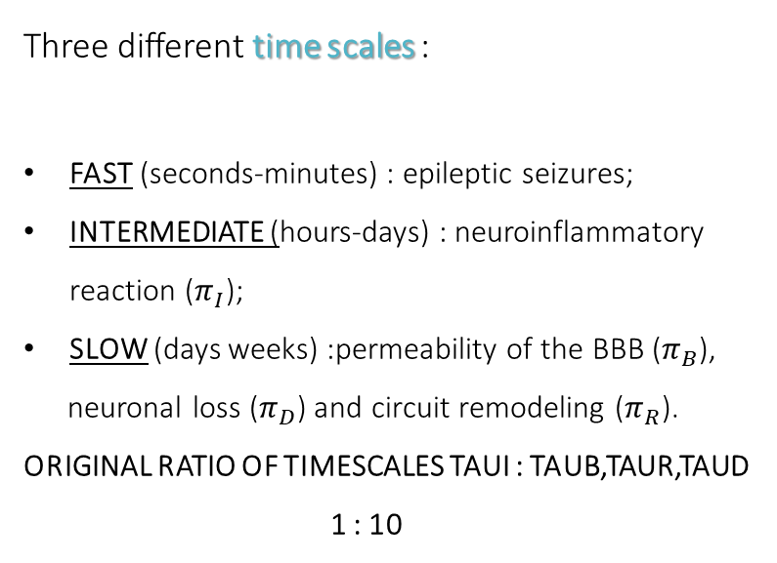
System of stochastic non linear ordinary differential equations:
Three different time scales :
FAST (seconds-minutes) : epileptic seizures;
INTERMEDIATE (hours-days) : neuroinflammatory reaction ($π_{I}$);
SLOW (days weeks) :permeability of the BBB ($π_{B}$),
neuronal loss ($π_{D}$) and circuit remodeling ($π_{R}$).
ORIGINAL RATIO OF TIMESCALES TAUI : TAUB,TAUR,TAUD
1 : 10
The variables:
I(t) is neuroinflammation intensity
B(t) is the extent of BBB disruption
D(t) is the extent of neuronal loss
R(t) is the degree of circuit remodeling.
All variables are assumed to be reversible, except for neural loss D(t)
ʘ is a neurotoxicity threshold
Dmax is a maximum possible extent of neuronal loss.

Slide 12
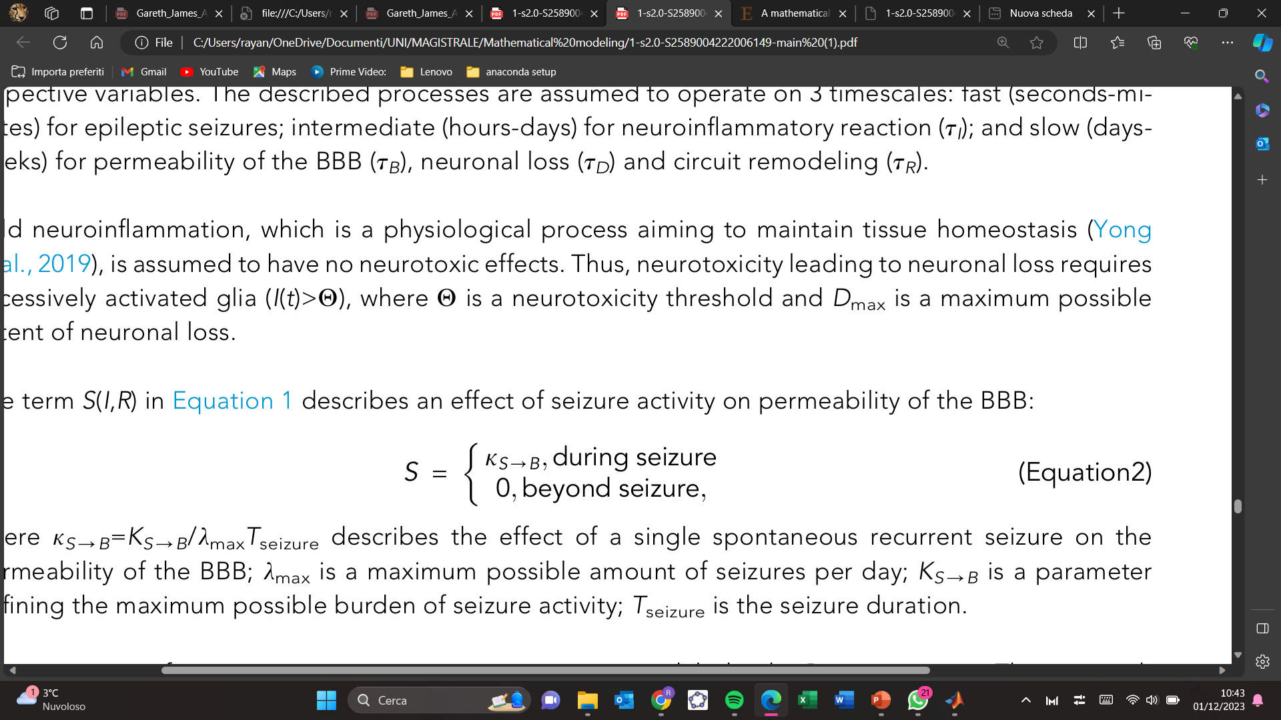
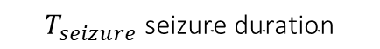
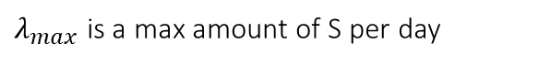
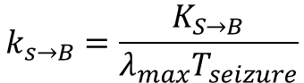
The term $S(I,R)$describes an effect of seizure activity on permeability of the BBB:
$k_{s→B}$ describes the effect of a single spontaneous recurrent seizure on the permeability of the BBB:
$$k_{s→B}=\frac{K_{S→B}}{λ_{max}T_{seizure}}$$
$$K_{S→B}\text{the} \text{maximum} \text{possible} \text{burden} \text{of} \text{seizure} \text{activity}$$
$λ_{max}$ is a max amount of S per day
$$T_{seizure} \text{seizure} \text{duration}$$
INTRODUCE STOCHASTICITY TO MODEL SPONTANEOUS RECURRENT SEIZURE …

Slide 13
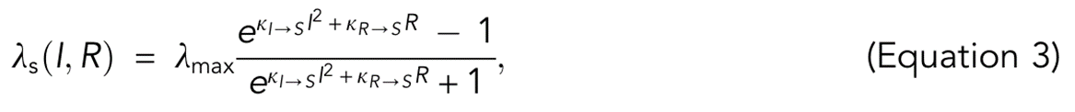
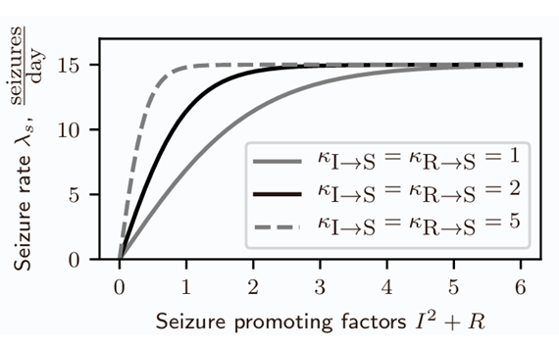
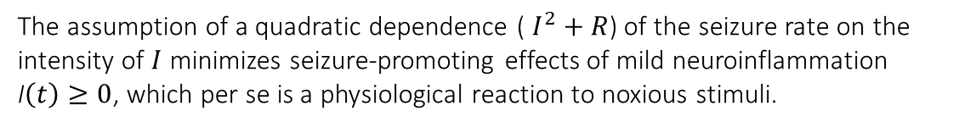
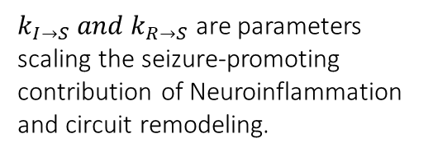
The occurrence of spontaneous recurrent seizures in time is modeled with a Poisson process :
$k_{I→S} and{ k}_{R→S}$ are parameters scaling the seizure-promoting contribution of Neuroinflammation and circuit remodeling.
The assumption of a quadratic dependence ( $I^{2}+R$) of the seizure rate on the intensity of $I$ minimizes seizure-promoting effects of mild neuroinflammation I$\left(t\right)≥0$, which per se is a physiological reaction to noxious stimuli.
Fig. 4 The sigmoid shape reflects the saturation effect of maximum possible seizure burden that nervous system may be exposed to within a finite time interval.

Slide 14
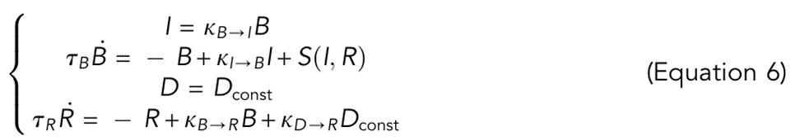
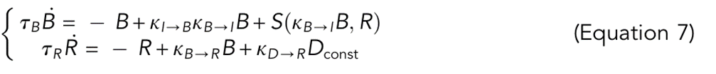
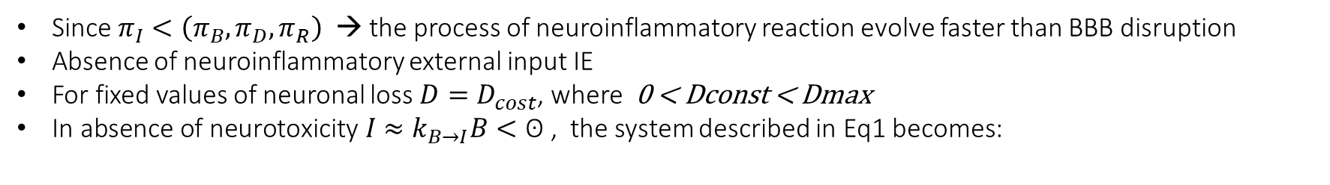
Time scale separation and rate model --- SIMULATED ONE.
Poisson process is approximated with a seizure burden function that does not allow for tracking the occurrence of individual seizures
Since $π_{I}<\left(π_{B},π_{D},π_{R}\right)$ → the process of neuroinflammatory reaction evolve faster than BBB disruption
Absence of neuroinflammatory external input IE
For fixed values of neuronal loss $D=D_{cost}$, where 0 < Dconst < Dmax
$\text{In} \text{absence} \text{of} \text{neurotoxicity} I≈k_{B→I}B<\text{ʘ}$ , the system described in Eq1 becomes:
The fast evolution of $I$ can be approximated by the dynamics: $I≈k_{B→I}B,$obtaining a system described in $B,R$dimensions

Slide 15
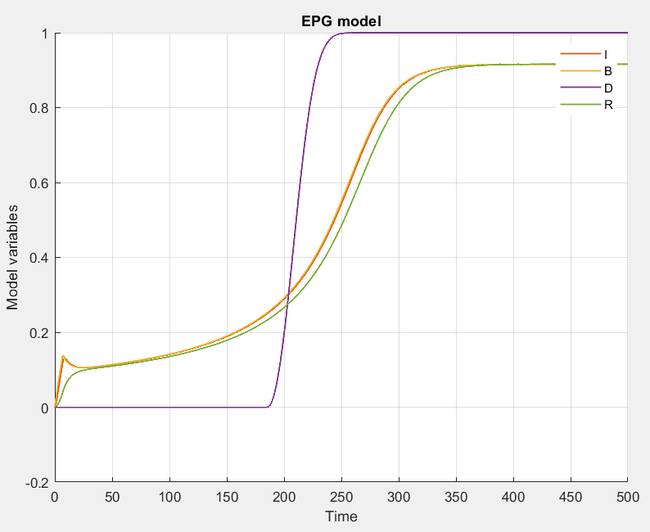
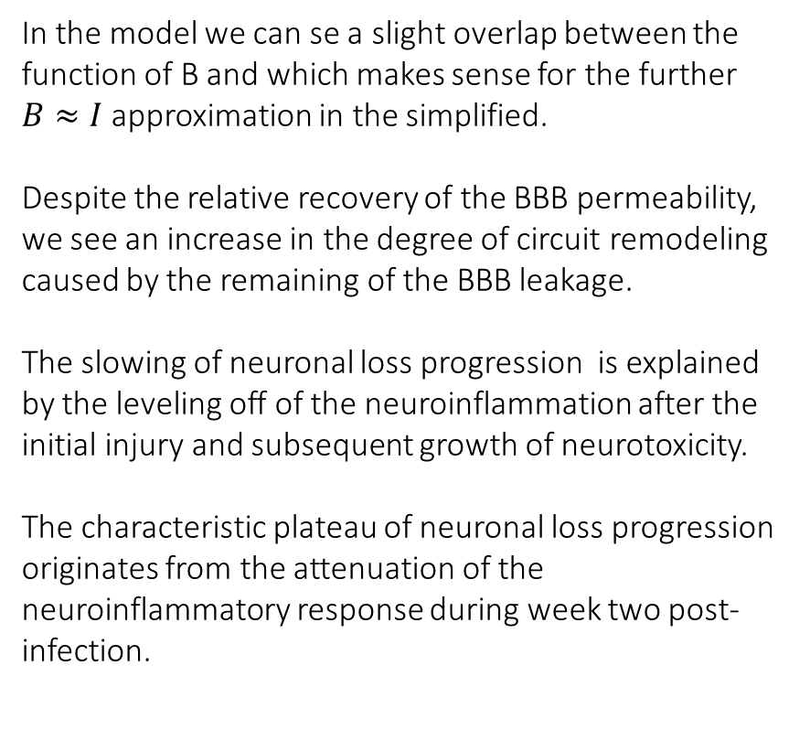
BBB DISRUPTION RATE MODEL
In the model we can se a slight overlap between the function of B and which makes sense for the further $B≈I$approximation in the simplified.
Despite the relative recovery of the BBB permeability, we see an increase in the degree of circuit remodeling caused by the remaining of the BBB leakage.
The slowing of neuronal loss progression is explained by the leveling off of the neuroinflammation after the initial injury and subsequent growth of neurotoxicity.
The characteristic plateau of neuronal loss progression originates from the attenuation of the neuroinflammatory response during week two post-infection.
Fig.5 Rate Model of the BBB disruptiuon animal model of epilepsy.

Slide 16
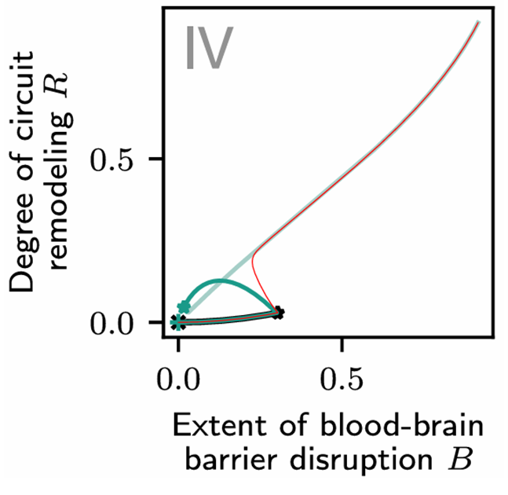
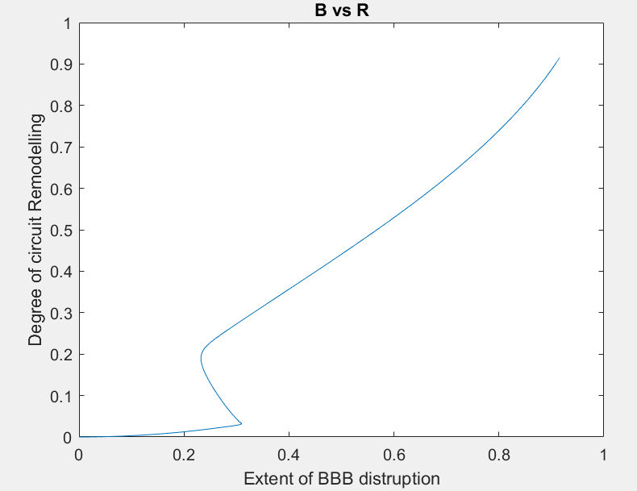
Compare the two simulations
Fig.6 Paper’s model implemented in Python.
Fig.7 Our’s model implemented on Matlab.

Slide 17
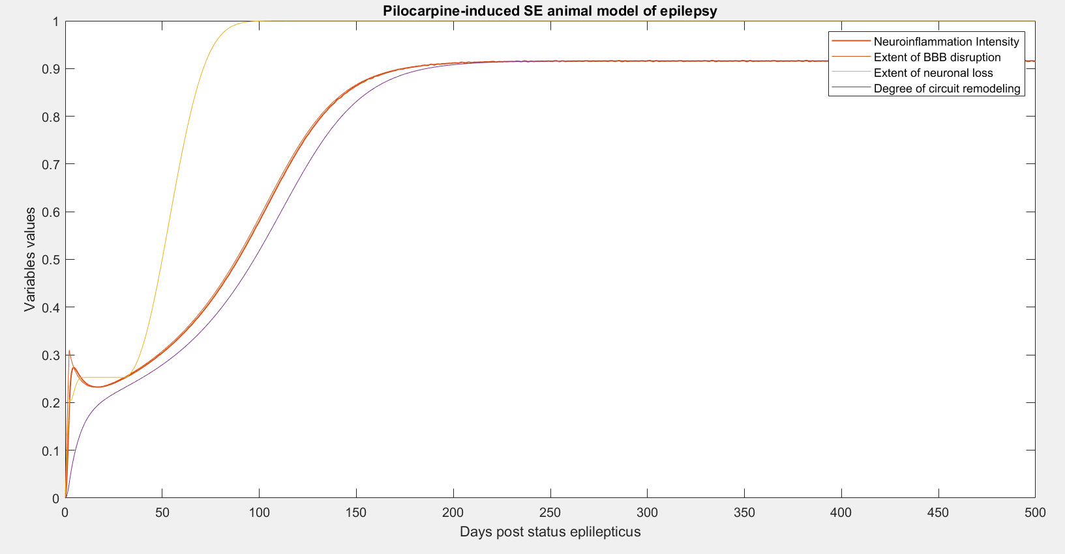
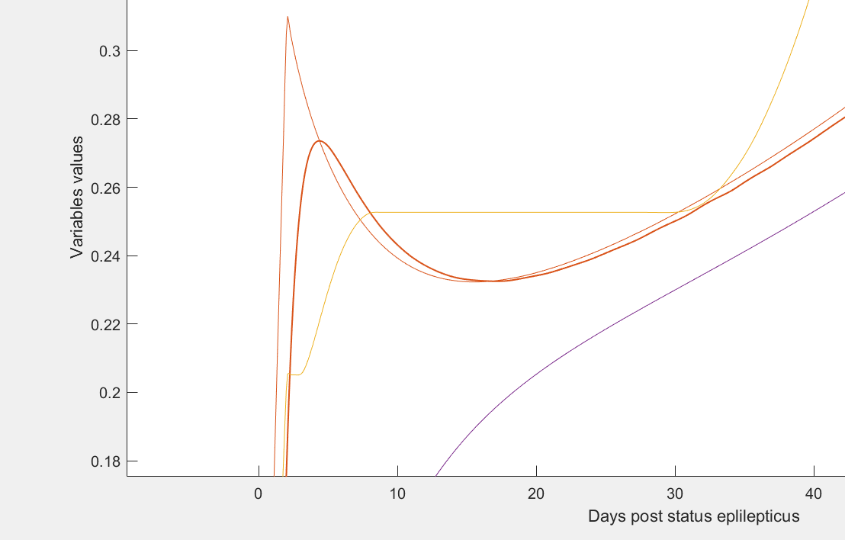
INFECTION INDUCED RATE MODEL
Neurotoxicity Threshold
PHASE OF RELATIVE RECOVERY
Fig.5 Rate Model of the Policarpine-Induced SE animal model of epilepsy.

Slide 18
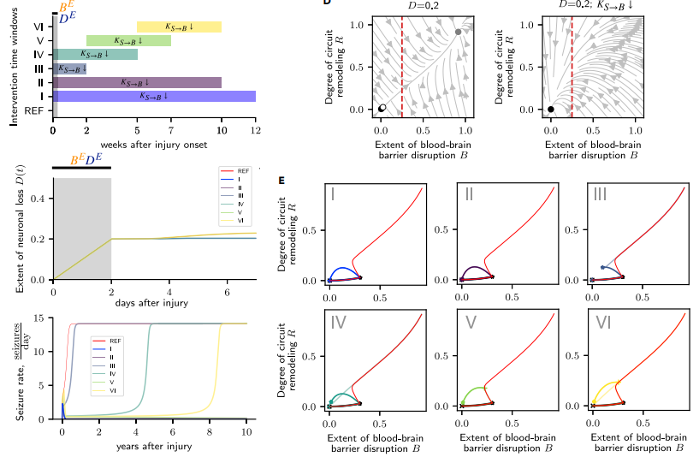
Modeling therapeutic intervention with suppression of seizure effect on BBB integrity reveals injury-specific time window for intervention in pilocarpine rodent model of epilepsy

Slide 19
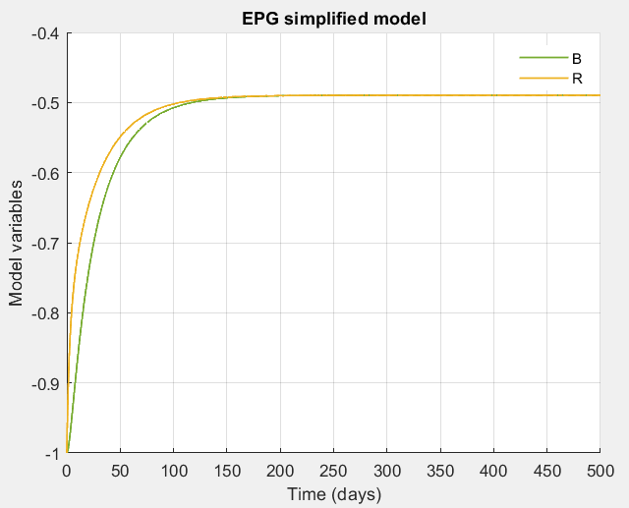
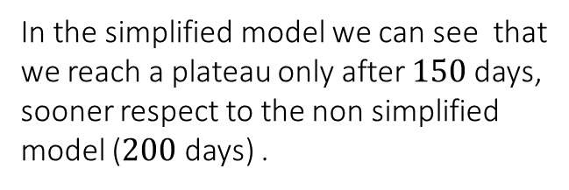
SIMPLIFIED MODEL WITH THE ASSUMPTIONS MADE BEFORE
In the simplified model we can see that we reach a plateau only after $150$days, sooner respect to the non simplified model ($200$ days) .
Fig.8 Rate Model Simplified

Slide 20
EQUILIBRIUM STUDY IN THE SIMPLIFIED MODEL

Slide 21
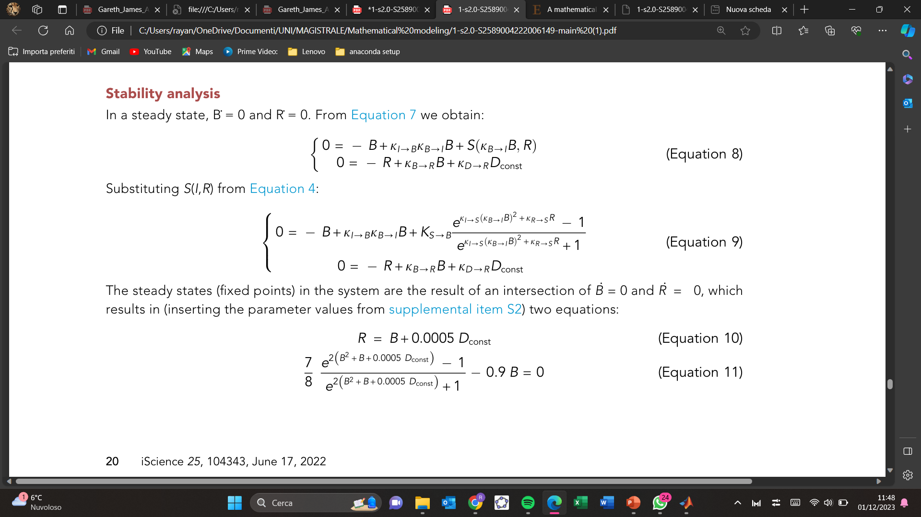
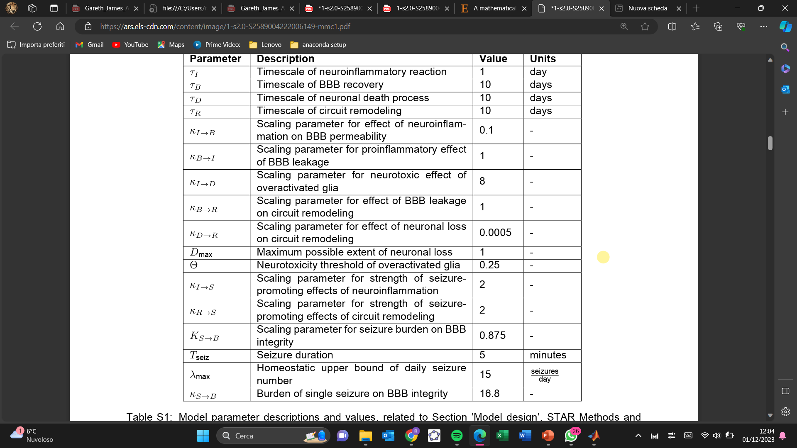
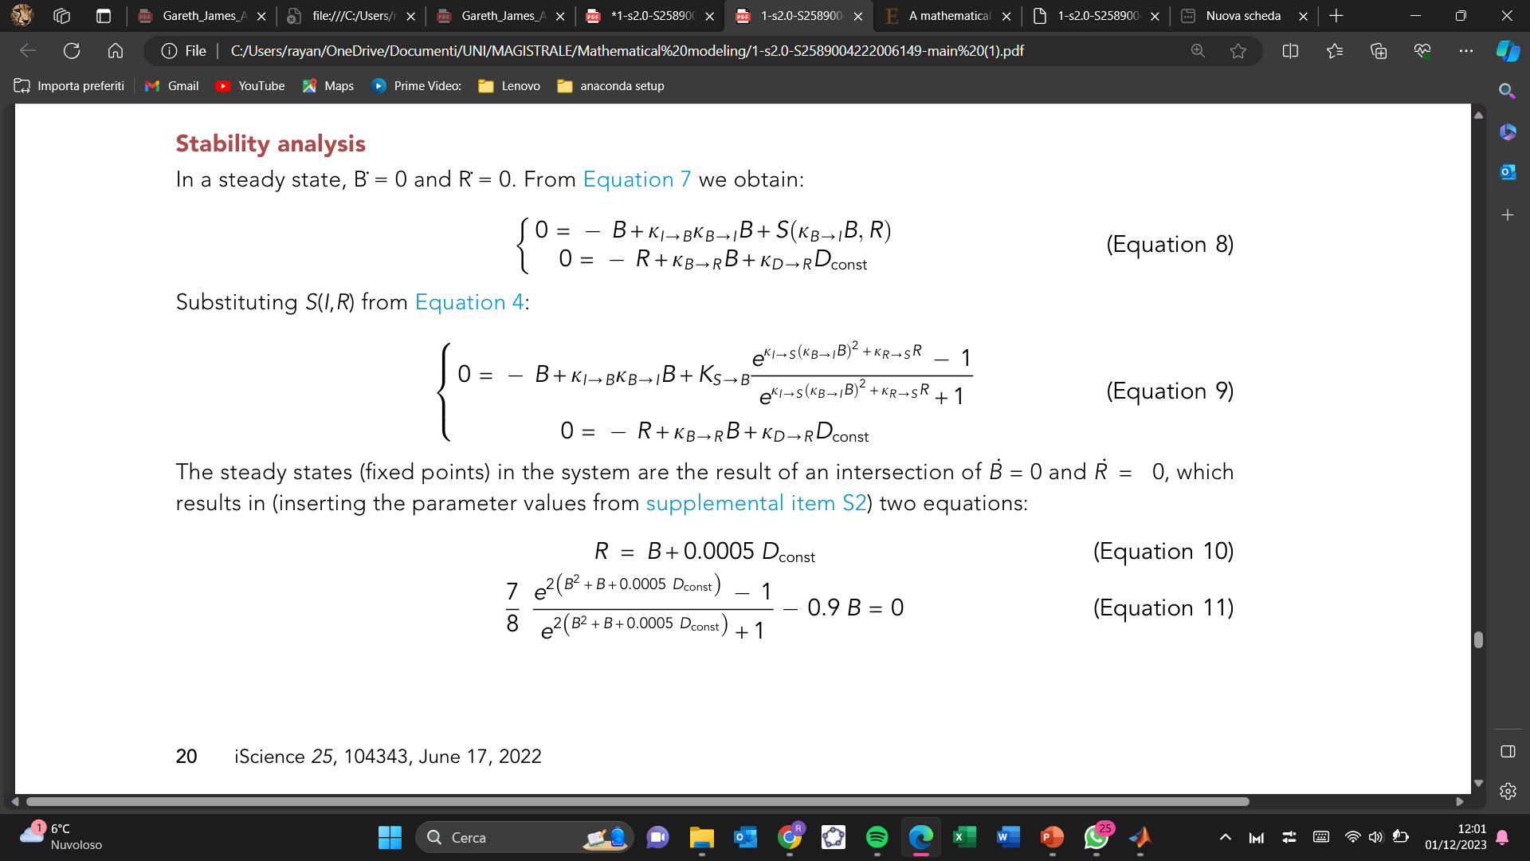

In a steady state $B^{.}=0 and{ R}^{.}=0$, and substituting $S(I,R)$we obtain:
The steady states (fixed points) in the system are the result of an intersection of $B^{.}=0 and{ R}^{.}=0$ , substituting the parameters from Tab.2, we obtain:
The Jacobian of the linearized system around each fixed point is:
Tab.1 Parameters value

Slide 22
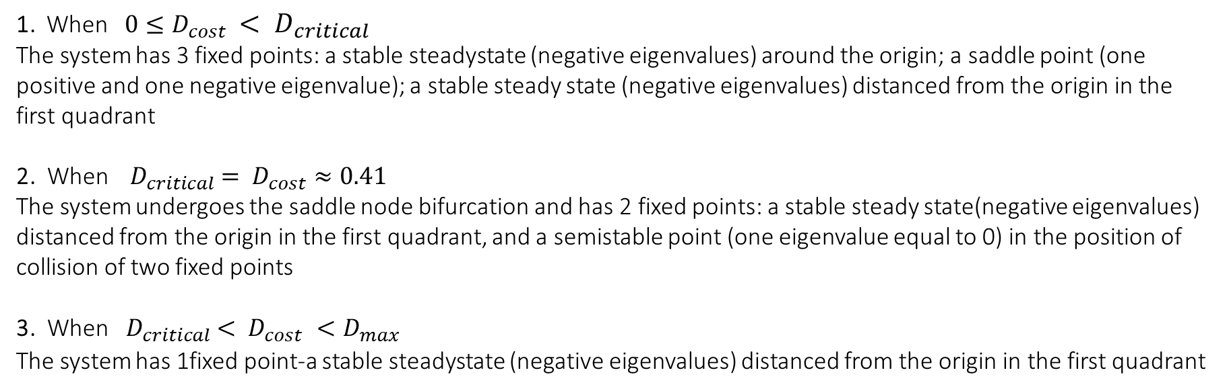
The eigenvalues for each fixed point in the phase plane $(B,R)$are the eigenvalues of the Jacobian evaluated at $B,R$. Analysing the fixed point positions and their corresponding eigenvalues, we can describe the state-space of the system:
1. When $0≤D_{cost }< D_{critical }$
The system has 3 fixed points: a stable steadystate (negative eigenvalues) around the origin; a saddle point (one positive and one negative eigenvalue); a stable steady state (negative eigenvalues) distanced from the origin in the first quadrant
2. When ${ D}_{critical }= {D_{cost}≈0.41}_{ }$
The system undergoes the saddle node bifurcation and has 2 fixed points: a stable steady state(negative eigenvalues) distanced from the origin in the first quadrant, and a semistable point (one eigenvalue equal to 0) in the position of collision of two fixed points
3. When${ D}_{critical }< {D_{cost}}_{ }<D_{max}$
The system has 1fixed point-a stable steadystate (negative eigenvalues) distanced from the origin in the first quadrant

Slide 23
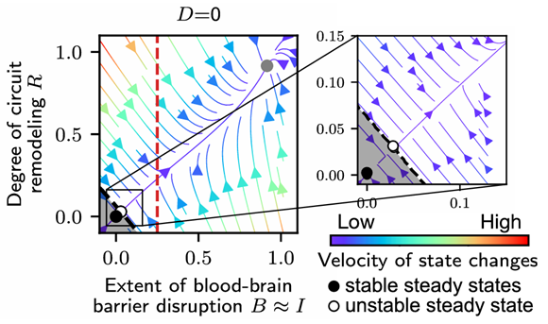
STATE SPACE REPRESENTATION
Stability analysis shows that in the absence of neuronal loss, the system is bistable, having 3 steady states:
‘healthy’ steady state in the origin
unstable fixed point
stable steady state corresponding to the state of progressed
A separatrix, illustrated with a black dashed line separates the basins of attraction of the two stable steady states.
The neurotoxicity threshold (for neuronal death) is illustrated with a red dashed line

Slide 24
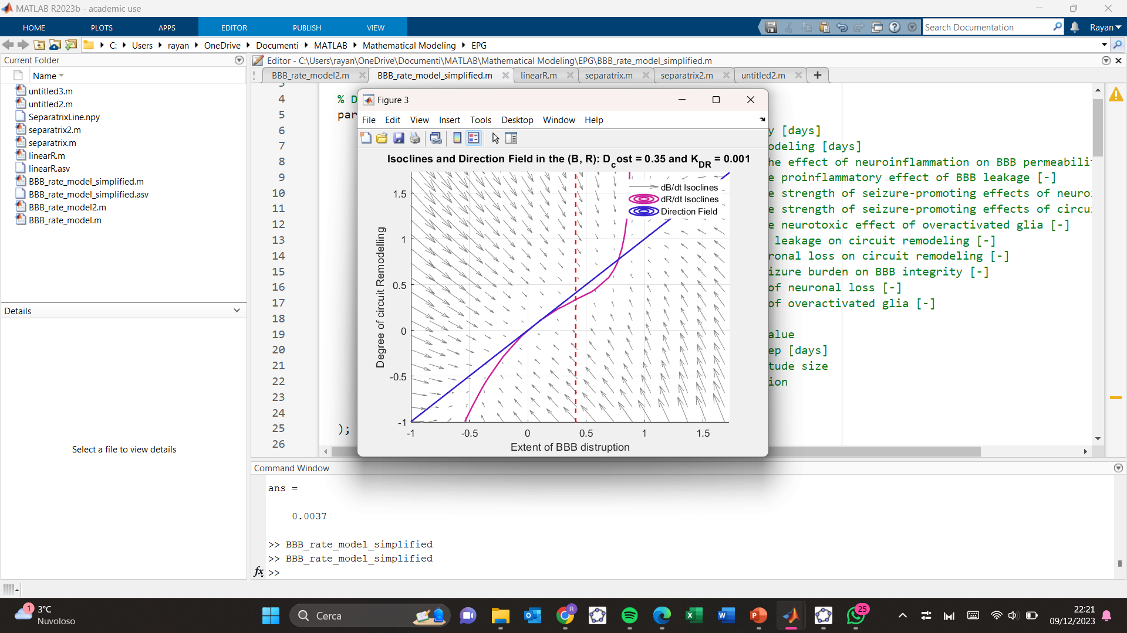
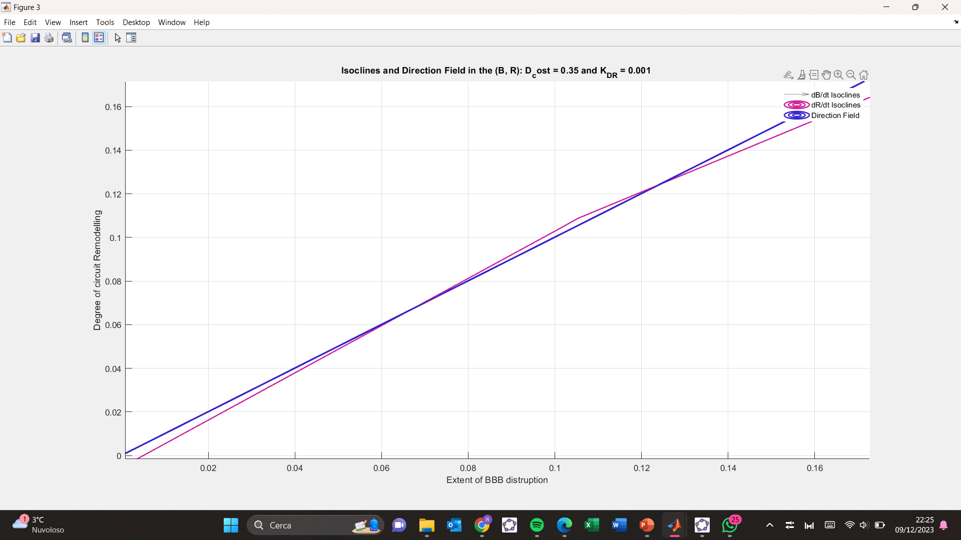
Our State-Space plot for the Rate model with three steady states
Here D < Dcritical
Fig. 9 dynamical landscape of the system simulating the rate model, wrt the parameters used in BBB disruption model.

Slide 25
Estimation of Critical Extent of Neuronal Loss

Slide 26
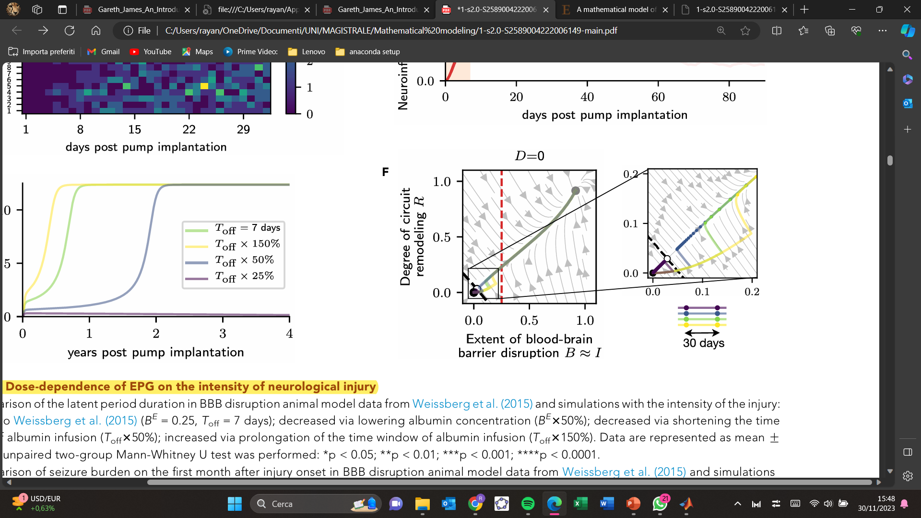
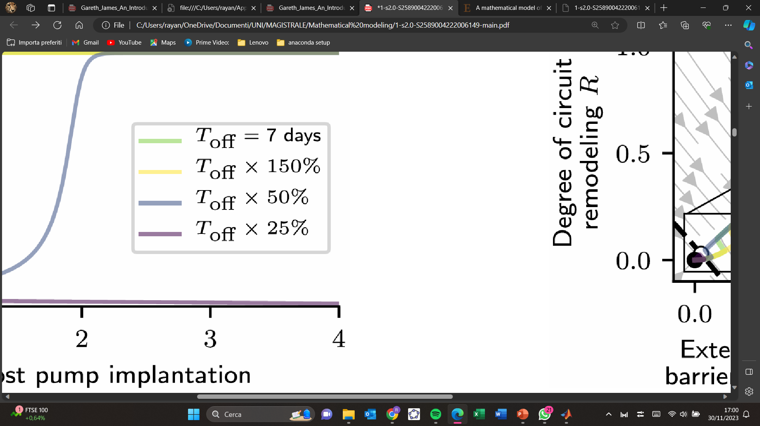
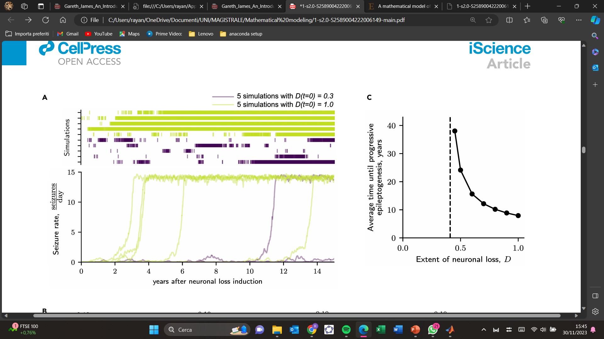
Role of neuronal loss (D) in epileptogenesis
EPG without cell death (D = 0) based on inflammation and BBB disruption alone.
Neuronal Loss is not NECESSARY for EPG induction.
Fig.10 Simulation of EPG with 4 different timing of induction.
Neuronal loss is sufficient but not necessary for inducing epileptogenesis
Fig.11 EPG progression in five simulations with supercritical ( D > Dcritical) and subcritical (D < Dcritical). On top seizure times of each simulation.

Slide 27
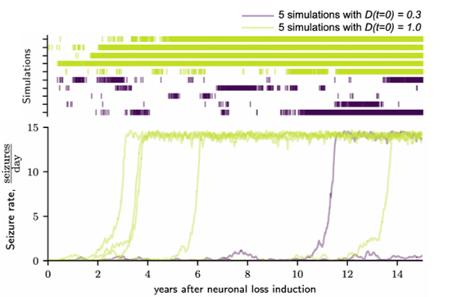
Fig.12 Average time until inevitable progressive EPG for different extents of neuronal loss obtained with rate model. The time of progressive EPG was heuristically calculated as the time from the start of the simulation to the time point of the neuro inflammation I(t) reaching 90% of the value corresponding to the ‘‘epileptic’’ steady state.

Slide 28
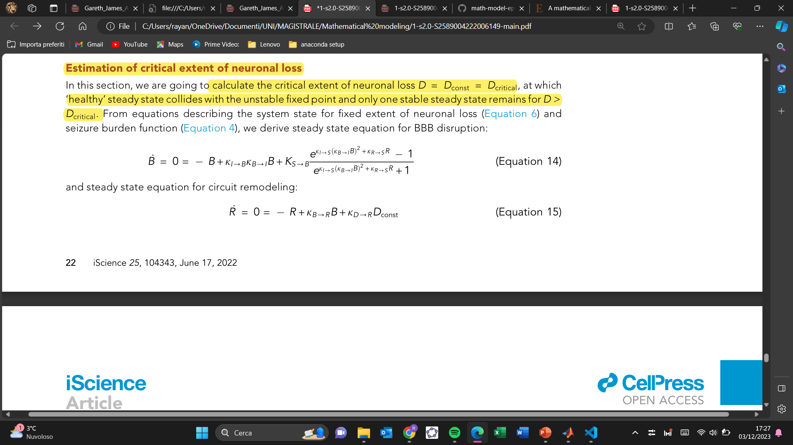
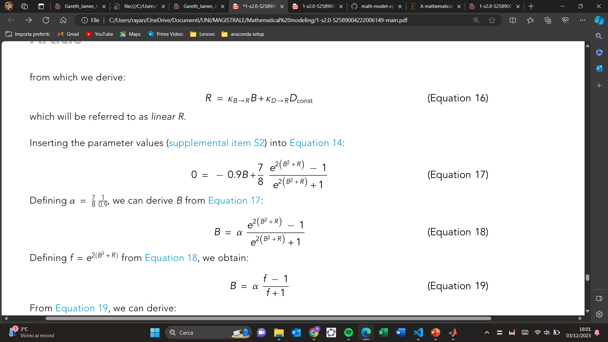

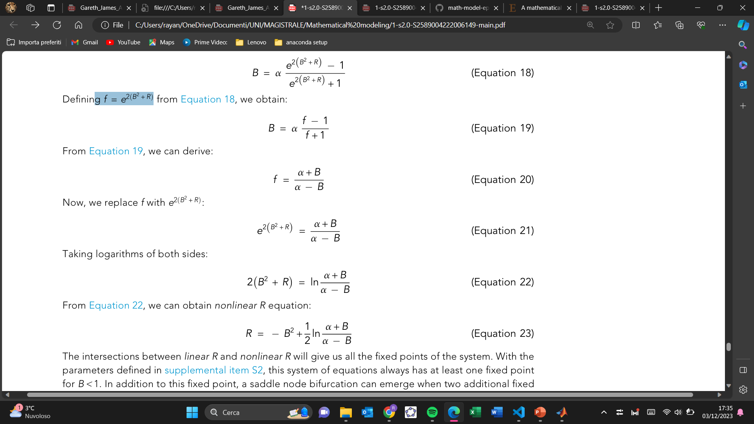
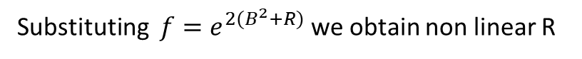
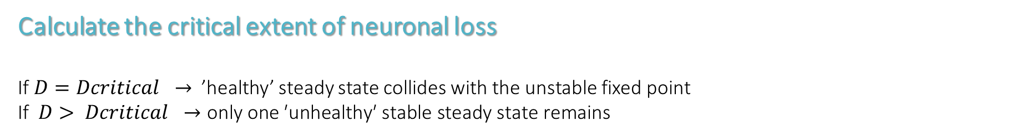

Calculate the critical extent of neuronal loss
If $D=Dcritical →$’healthy’ steady state collides with the unstable fixed point If $D> Dcritical →\text{only} \text{one} \text{′}\text{unhealthy}\text{′ }\text{stable} \text{steady} \text{state} \text{remains}$
Steady state equation for BBB disruption
Substituting the parameters
Steady state equation for circuit remodeling (linear R):
Defining $a=\frac{7}{8}\frac{1}{0.9}$ , and $f=e^{2(B^{2}+R)}$ we obtain
Substituting $f=e^{2(B^{2}+R)}$ we obtain non linear R

Slide 29

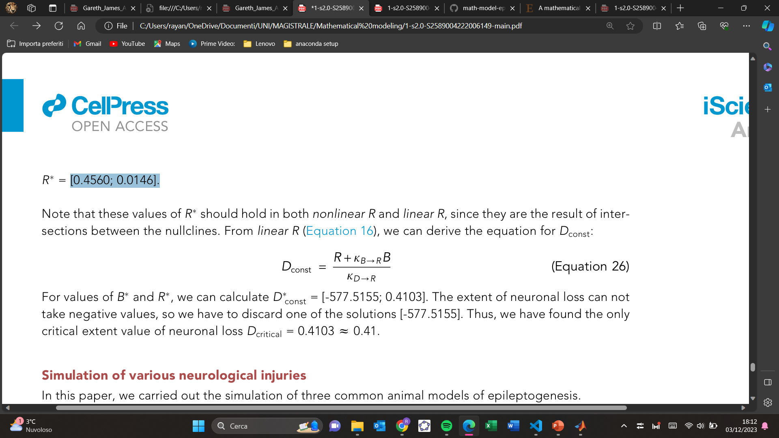
The intersections between linear R and non linear R will give us all the fixed points of the system. Assuming that D could be a bifurcation parameter -> we need to find its critical value such that linear R becomes tangential to non linear R
first derivative of non linear R with respect to B
Find all those values B = s, where s is equal to the slope of linear R ($k_{B→R}=1$ )
W e obtain $B^{∗} =[0.7448;0.0143],$and substituting we obtain $R^{∗}=\text{[0.4560; 0.0146]}$
Now looking for $D_{Dconst}$, we obtain the critical value $D_{Dconst}≈0.41$

Slide 30

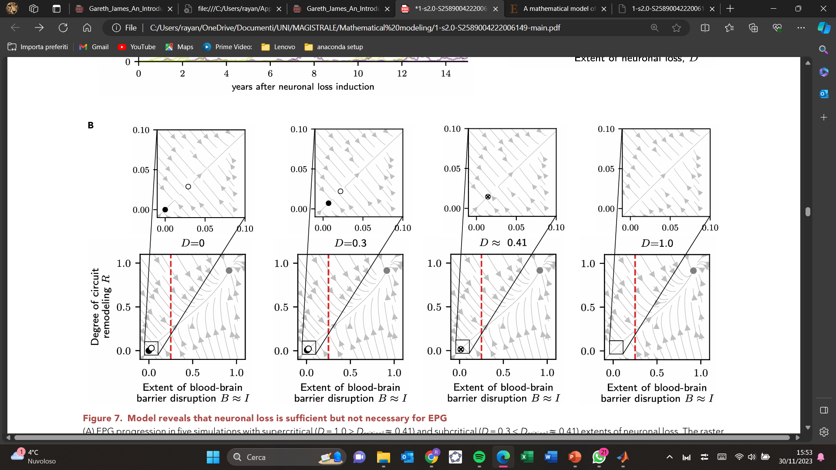
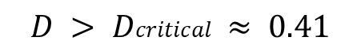
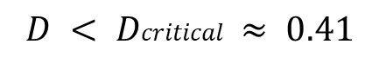
$$D < Dcritical ≈ 0.41$$
$$D > Dcritical ≈ 0.41$$
The stable and unstable fixed point move toward each other, resulting in a non-zero seizure rate. There is spontaneous seizure [stochasticity] that does not necessarily lead to Epileptogenesis onset.
Here we can see a SADDLE NODE BIFURCATION in which the ‘‘healthy’’ steady-state collides with the unstable fixed point at a certain value of neuronal cell loss. Then the development of progressive EPG toward the Epileptic steady-state is inevitable .
Fig.13 The effect of neuronal loss on the system stability is illustrated with state-space plots

Slide 31








The effect of neuronal loss on the system stability is illustrated with state-space plots in our model
$$D=0$$
$$D=0.3$$
0.0038
0.0028
$$D≈0.41$$
$$D=1$$
0.0013

Slide 32
MODEL PARAMETERS CHOICE

Slide 33


Parameter values were, whenever possible ,directly extracted from the experimental data of some papers.
For parameters not directly measurable, stability analysis of the system and manual parameter search were carried out.
The maximum possible extent of neuronal loss $Dmax$ is a parameter that constraints the parameter space ($Dmax = 1$)
TAU ESTIMATION → data on microglial motility
NEUROTOXICITY THRESHOLD of overactivated glia Q was manually fit
Tab. 2 Parameters of the rate model

Slide 34





By default, all parameters were set equal to unity. However, the presence of the positive feedback loop between $I$and $B$ imposes the constraint on the $k_{I→B}$ and $k_{B→I}$ parameters, which can be derived considering the subsystem :
Fig.14b Steady state distribution for the extent of BBB disruption illustrated for the original parameters ( top ) , alternative parameter set with higher $k_{I→B}$, and on the bottom alternative parameter set with lower $K_{S→B}$
Applying the stability analysis
we obtain the inequality $k_{I→B}k_{B→I}≤1$
This considered, $k_{I→B}$ was set to the value 0.1 and the value of $K_{S→B}$ was estimated manually
Redundancy in the parameter space

Slide 35




$k_{s→B}$ → scaling seizure burden in the system → estimated with stability analysis
Fig.15 State-space plot used for comparing different values of $k_{s→B}$ . The black dashed lines corrispond to the nullclines $B^{.}=0 and R^{.}=0$. The grey lines corrispond to nullclines
$k_{I→D}$ → scaling parameter of neurotoxic effect of overactivated glia → manually fit
Fig.16 Comparison between model and simulations for $k_{I→D}$

Slide 36



Parameter Selection $K_{S→B}$
Fig.17 Phase plane for several values of $K_{S−>B}$ in our simplified model
For low values of $K_{S−>B}$ the system have only one healty steady state; for higher values of $K_{S−>B}$ the healthy stable node and the unstable node diverges from each other, and the B isoclines assumes a different shape. A value $K_{S−>B}≈0.875$ looks like a good compromise for keeping the system stable and the stable ‘healthy’ state and the unstable state close to each other.

Slide 37



Parameter Selection $k_{D→R}$
A) For low $k_{D→R}$ the system loses sensitivity to changes of D, (no steady state location changes for $D≠0$).
B) For $k_{D→R}=0.0005$ the system is stable and sensitive
C) For low $k_{D→R}$ the system loses stability (no steady state for $D≠0$ )
Fig.18 Effect of $k_{D→R}$ on the system stability

Slide 38









Effect of changing $D_{const}$ and $K_{D→R}$ on system’s stablity
$$D_{const}=0$$
$$D_{const}=0.35$$
The effect of $K_{D→R}$ parameter on the stability of the system is illustrated in conditions of non-zero neuronal loss $D_{const}$ .
lowered parameter value of $K_{D→R}$ → the system loses sensitivity to changes in neuronal loss (in $K_{D→R}\text{=0.0055 }$we can see that the stable and the unstable node move toward each other).
elevated parameter of value of $K_{D→R}$ → the system loses stability (disappearance of the steady states)
$$K_{D→R}=0.0001$$
$$K_{D→R}=0.001$$
Fig. 19 State-space plots for the alternative parameter value: $K_{D→R}$=0.0001, $K_{D→R}$=0.001.

Slide 39




Effect of ${ K}_{I→S}$ and $K_{R→S}$ on the system’s stablity
Fig. 20 State-space plots for the alternative value of $K_{I→S}$ $K_{R→S}$ .
$K_{I→S}$ is a parameter for the strength of seizure-promoting effects of neuroinflammation, while $K_{R→S}$ is a parameter for the strength of seizure-promoting effects of circuit remodeling. For low values the system has only one stable ‘healthy’ state. For higher values in the system we can see that the unstable moves toward the ‘EPG’ stable state. Instead for intermediate value, $K_{I→S}=K_{R→S}=2$, the system in stable.

Slide 40
Prons of the model
the multi causal and stochastic nature of epilepsy.
the existence of two stable fixed points, representing the healthy state and the state of developed epilepsy
explanation for the emergence of long timescales despite time-limited injuries
injury specific time courses
Limits of the study
not considering the genetic predisposition
neuroinflammation is very simple
not considering different kind of seizure
brain is a very stochastic environment

Slide 41
Bibliography
Batulin et al., iScience 25, 104343 June 17, 2022 The Author(s). doi.org/10.1016/ j.isci.2022.104343, A mathematical model of neuroimmune interactions in epileptogenesis for discovering treatment strategies.

